Slide 1

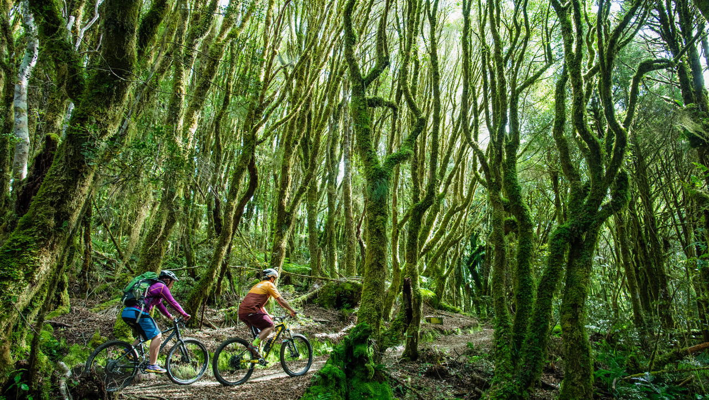

TRENZ 2026

Slide 2

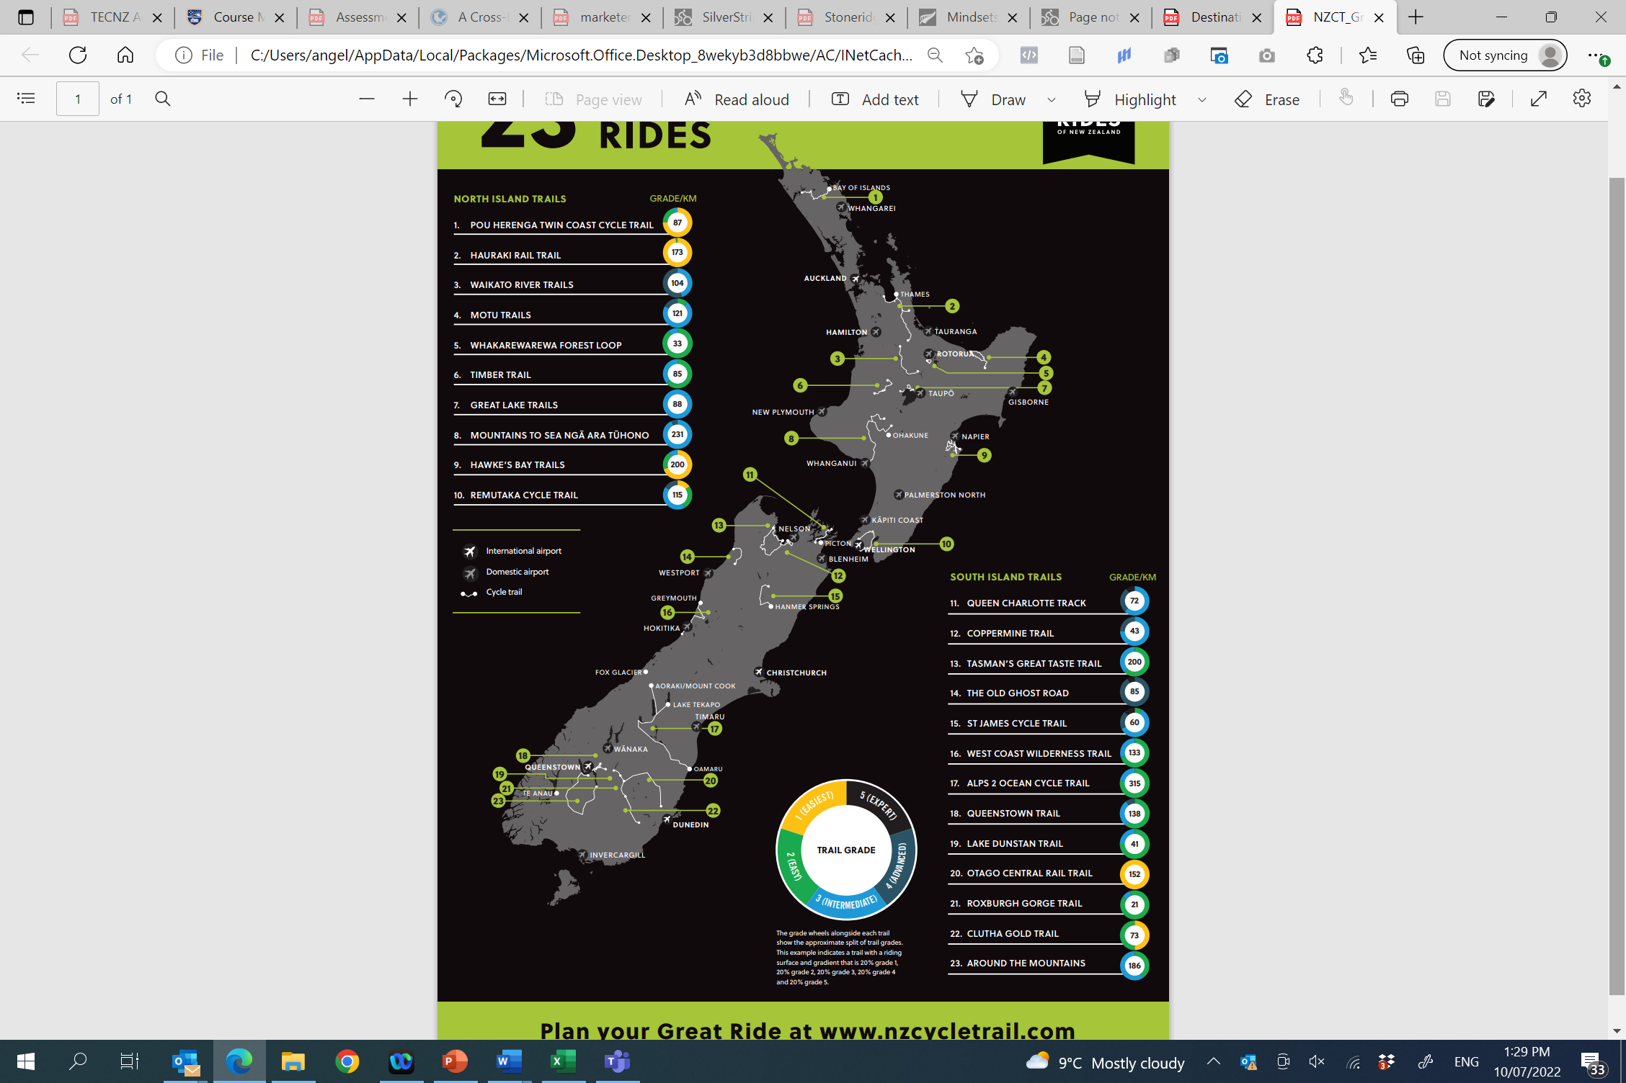
Key Takeaways
23 Great Rides of New Zealand
Trails are mostly off road
Premium cycling experience
Cycle a section of a Great Ride (1-2 hours)
Multi-day (2-7 days)
Export ready cycle operators
High level of infrastructure (bike hire, shuttle, accommodation, guided or self-guided)

Slide 3
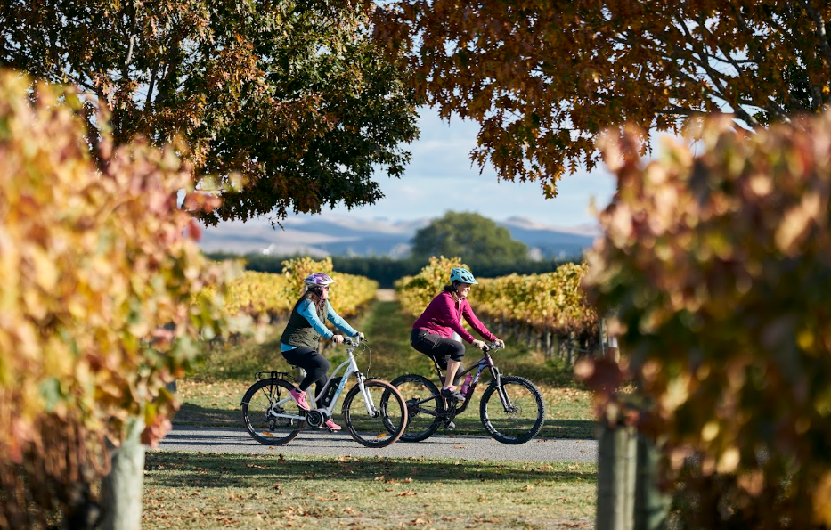
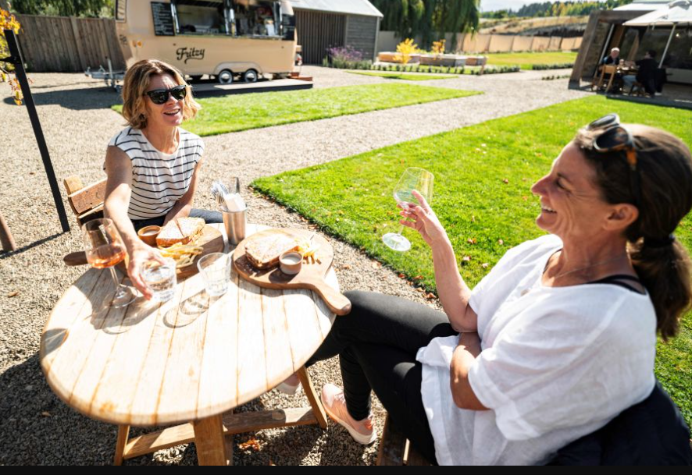
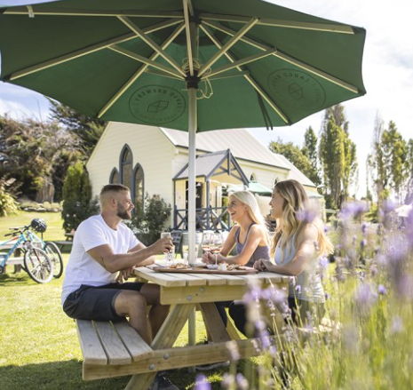
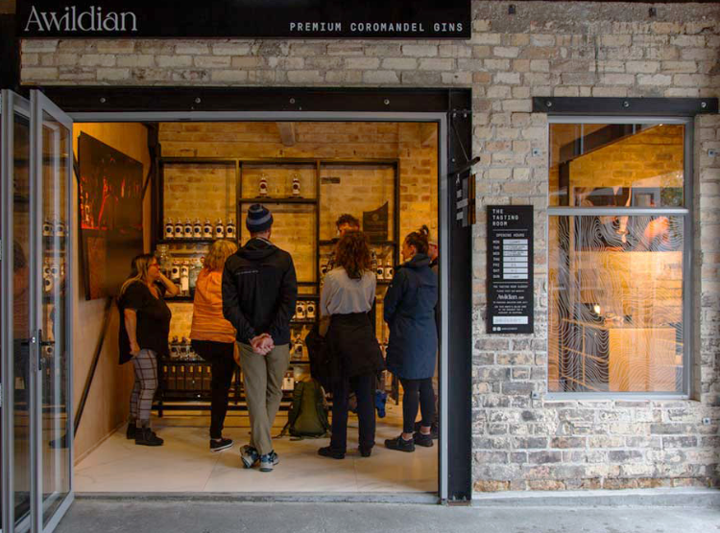

Wine & Food

Slide 4
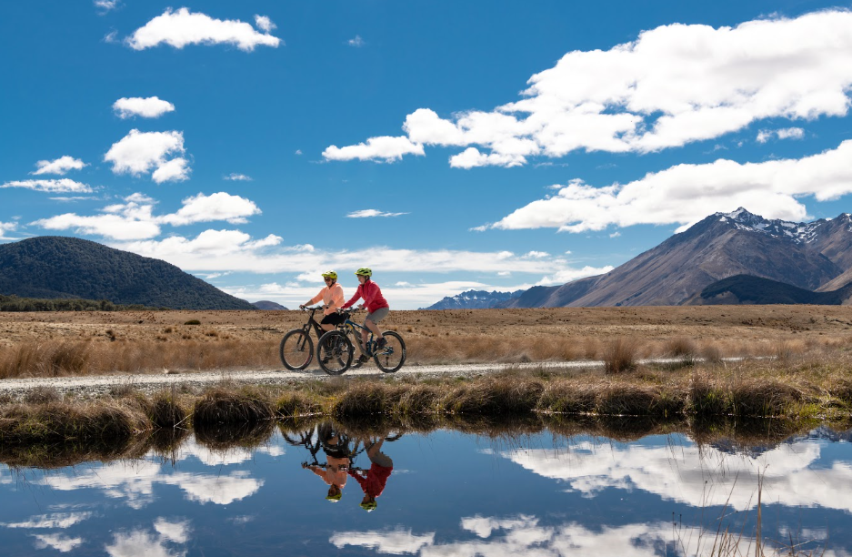
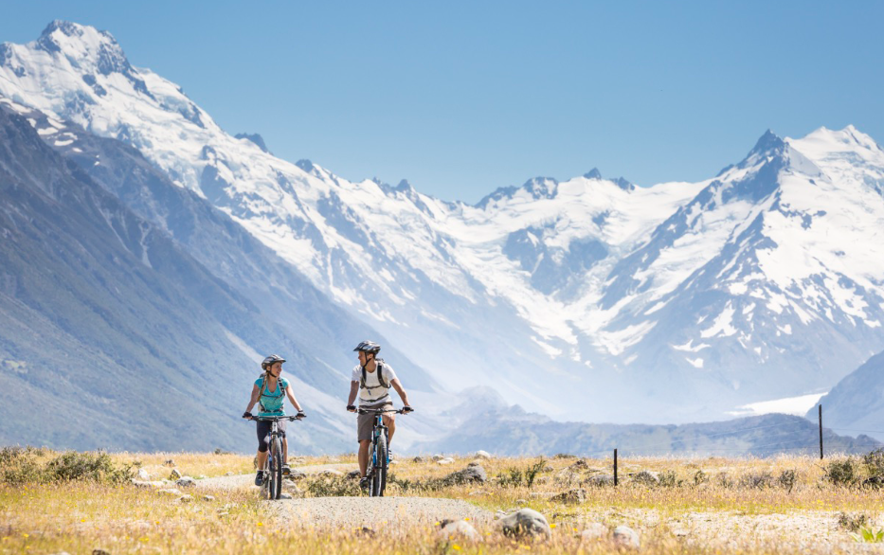
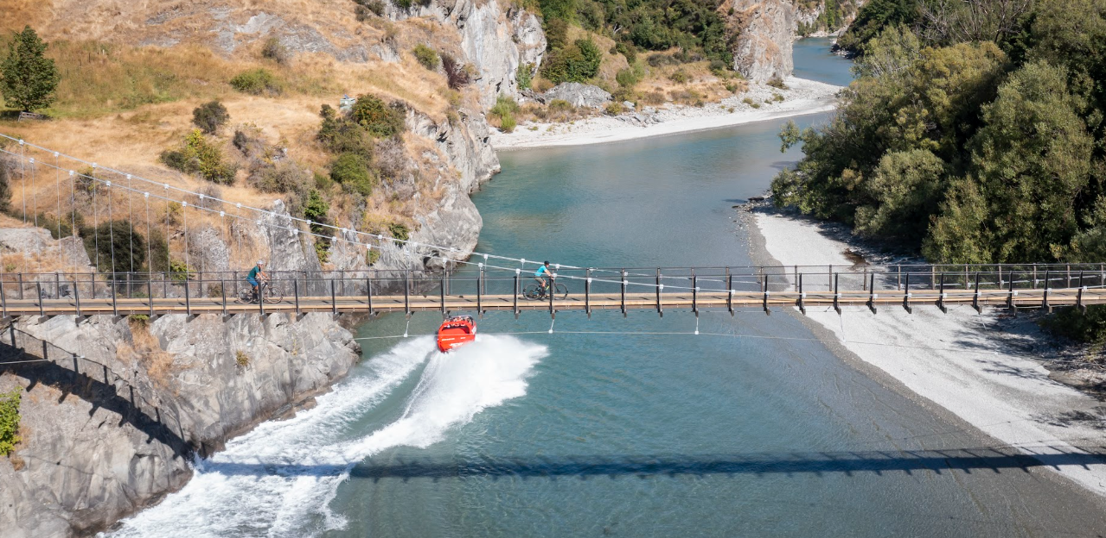
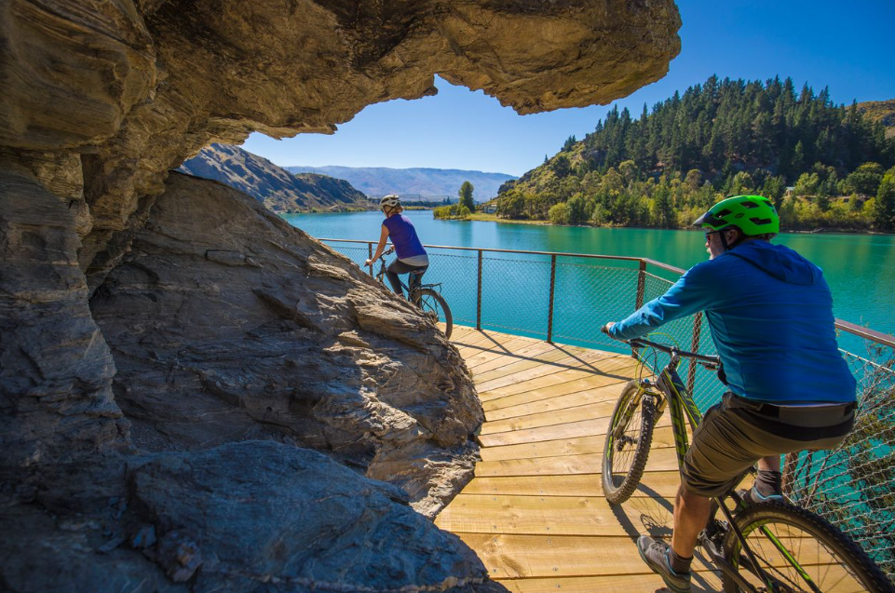
Spectacular Scenery

Slide 5
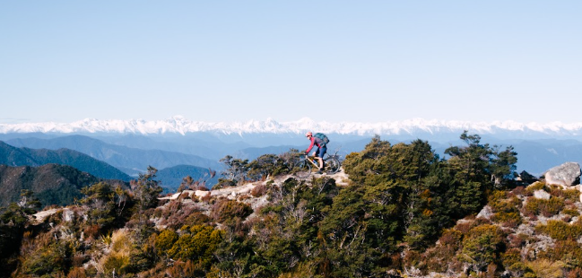
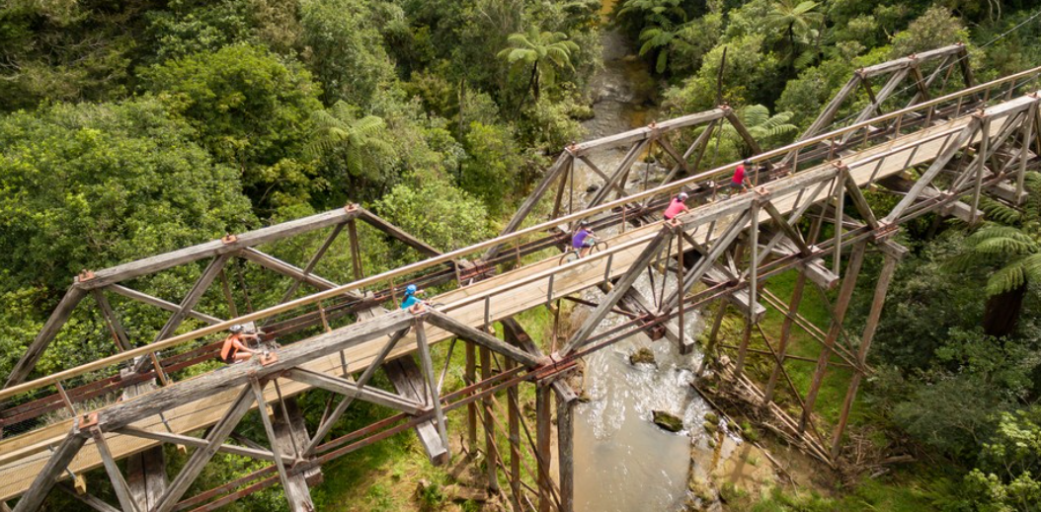
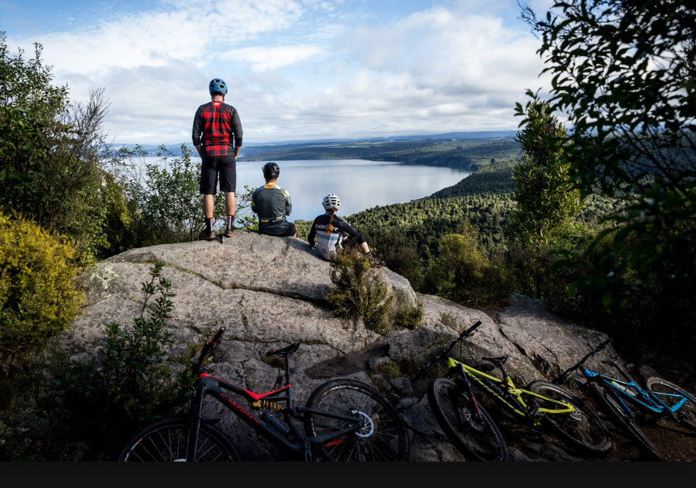
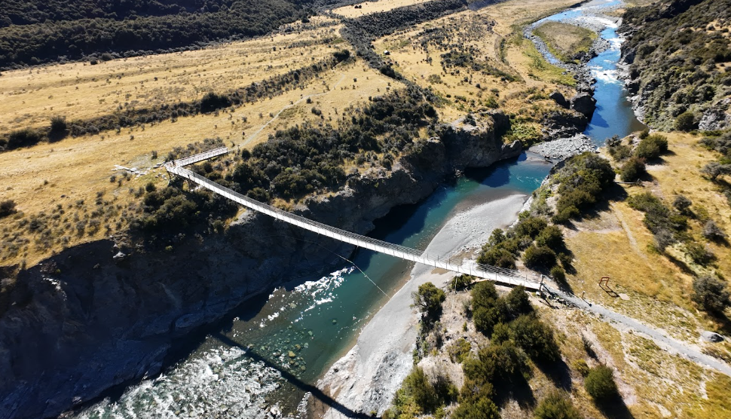
Remote Wilderness

Slide 6
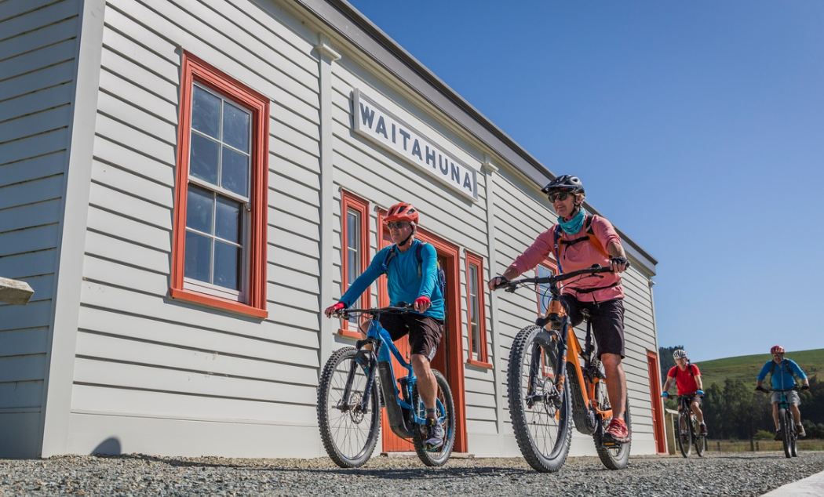
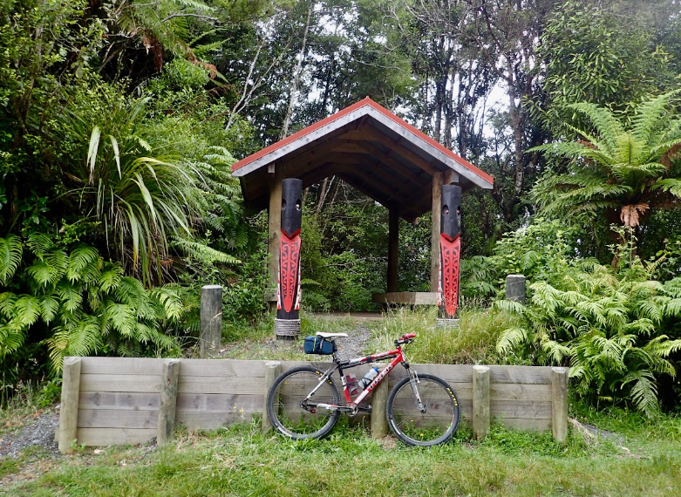
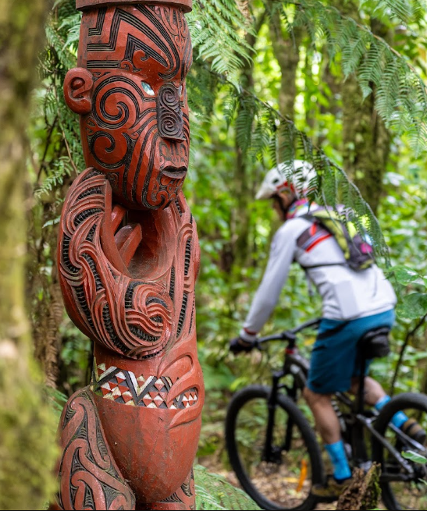
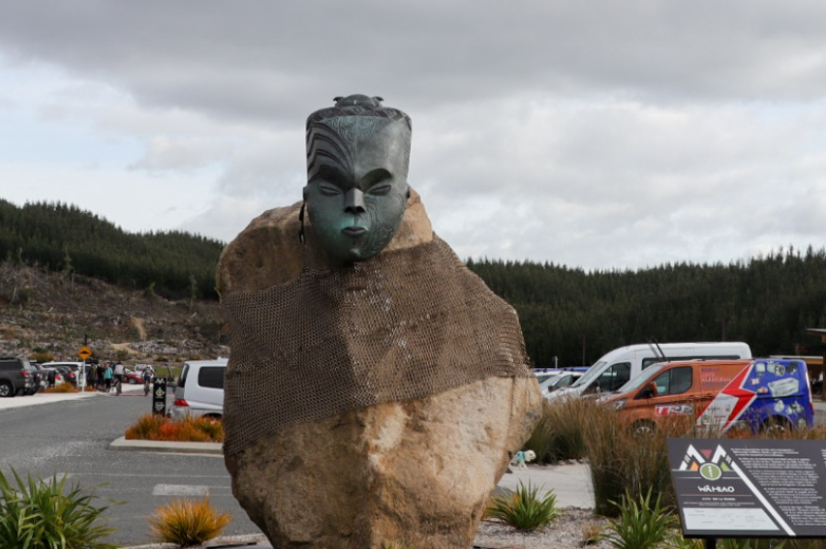
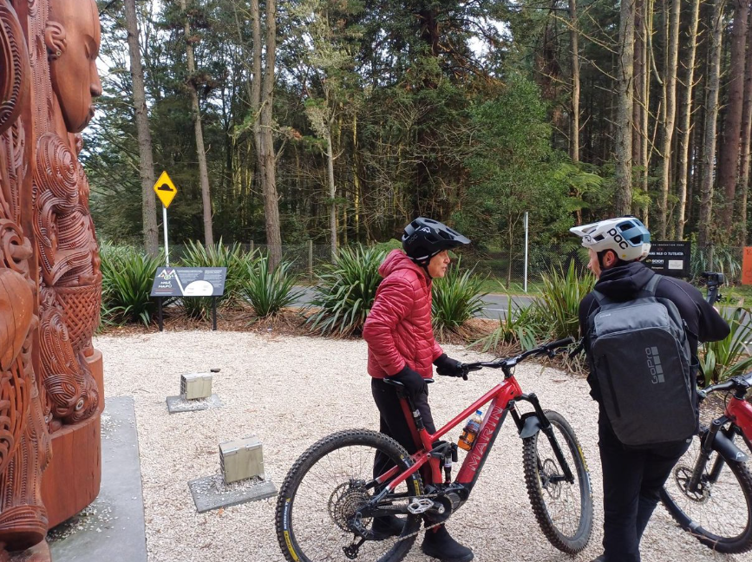
Culture & Heritage

Slide 7
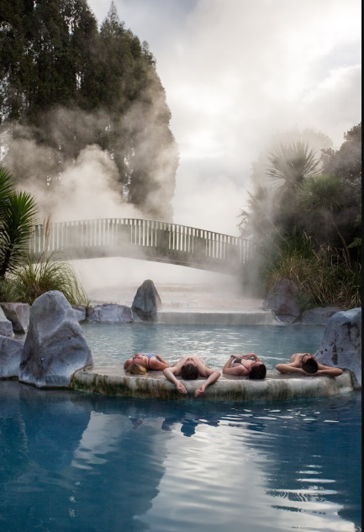
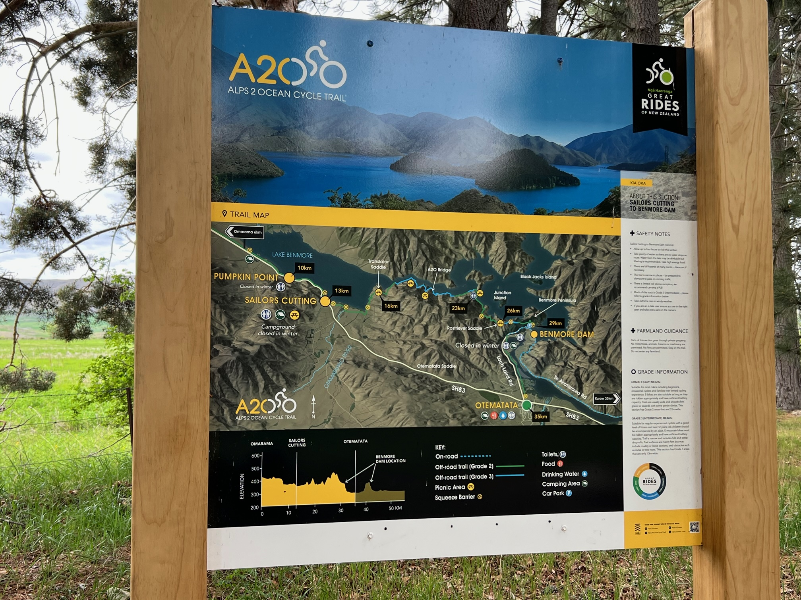
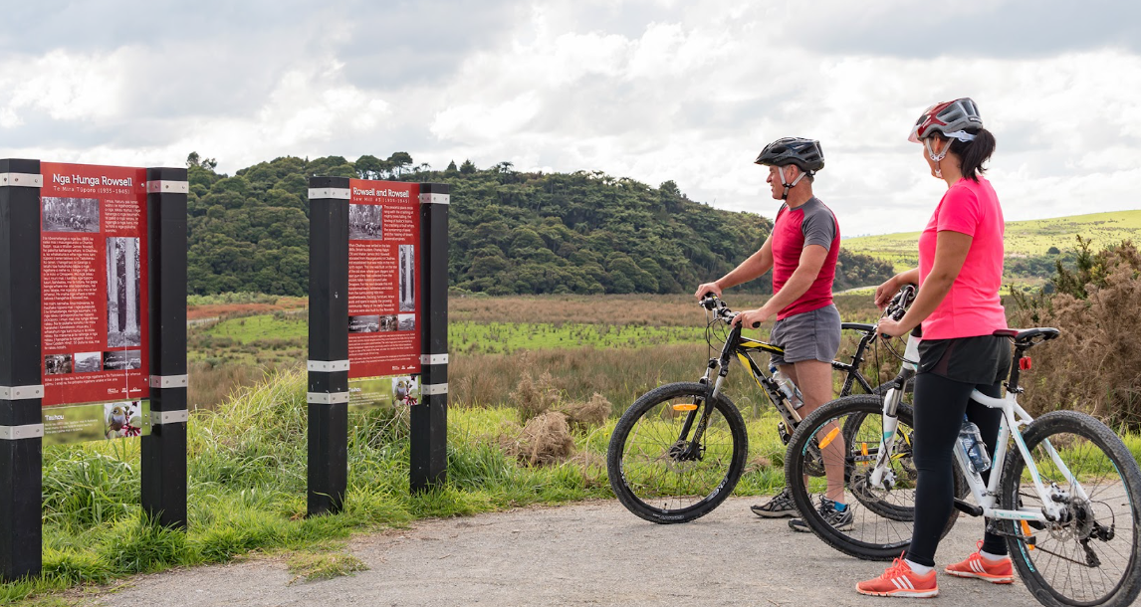
Trail Grade for Great Rides
  Grade 1 (yellow) Easiest to Grade 5 (black) Expert
Trail Signage
  Wayfinding
Seasonality
  Spring & Autumn
  Winter riding
  Summer (peak)

Slide 8
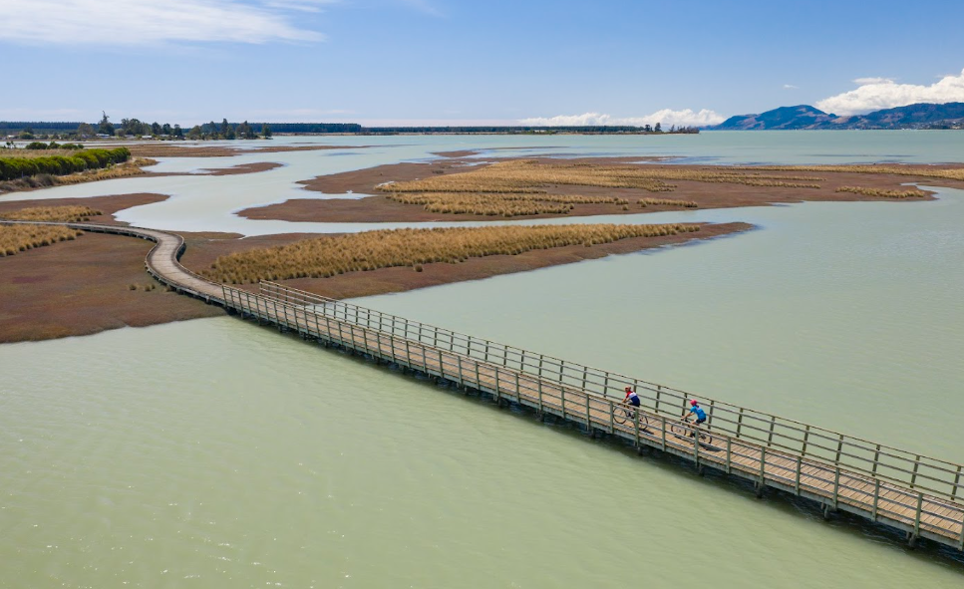
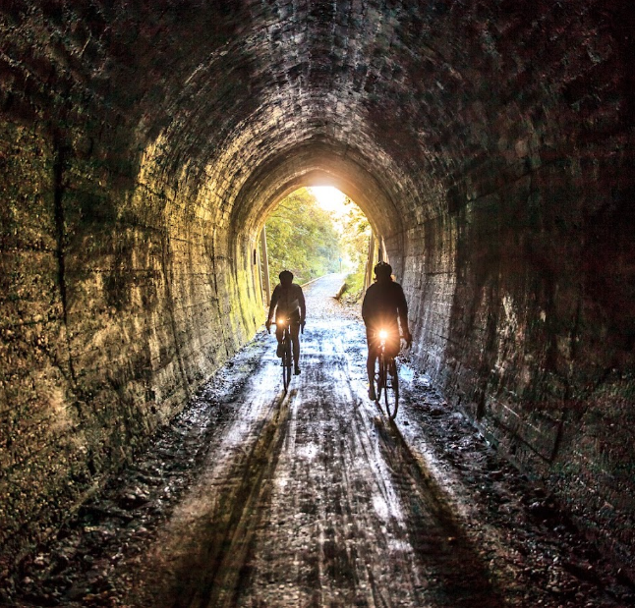
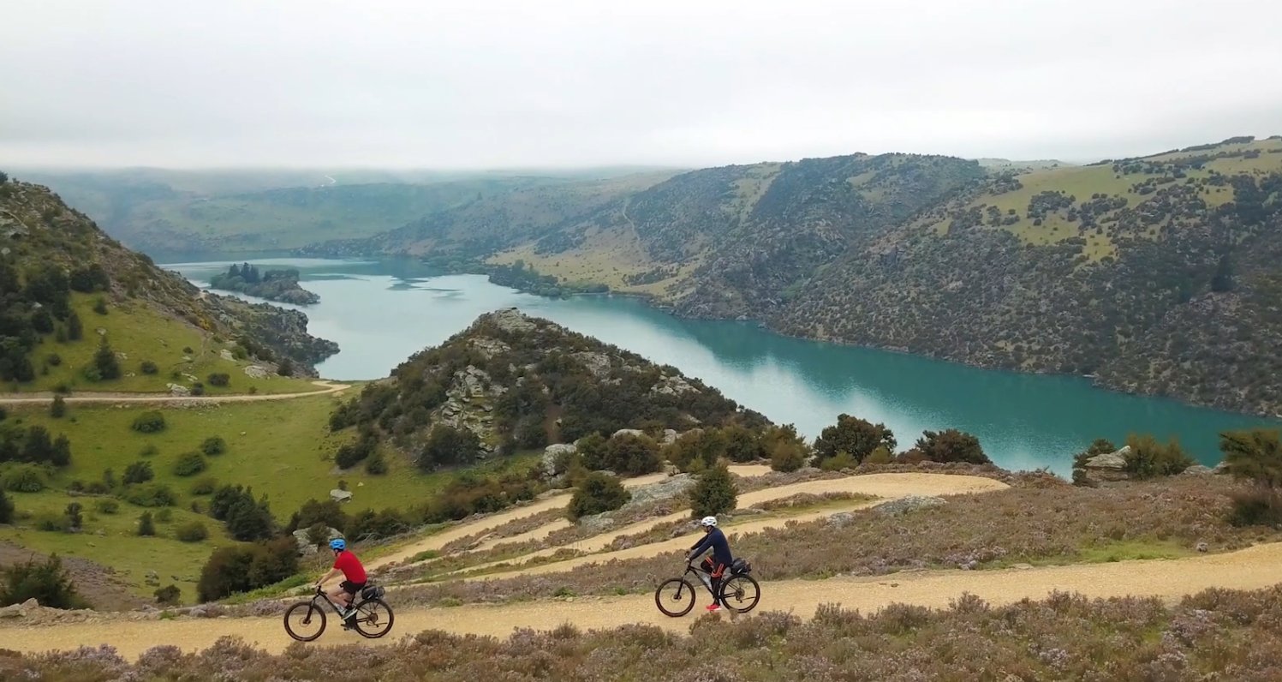
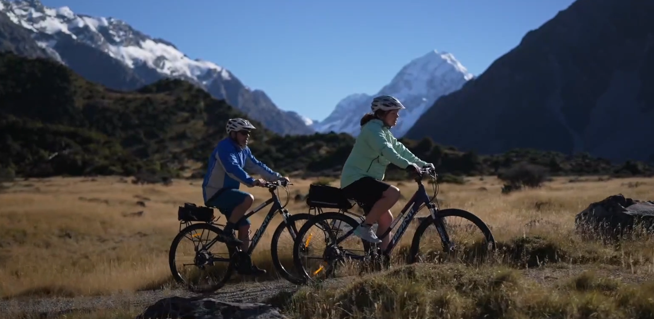
Grade 1 & 2 – riding on flat smooth paths

Slide 9
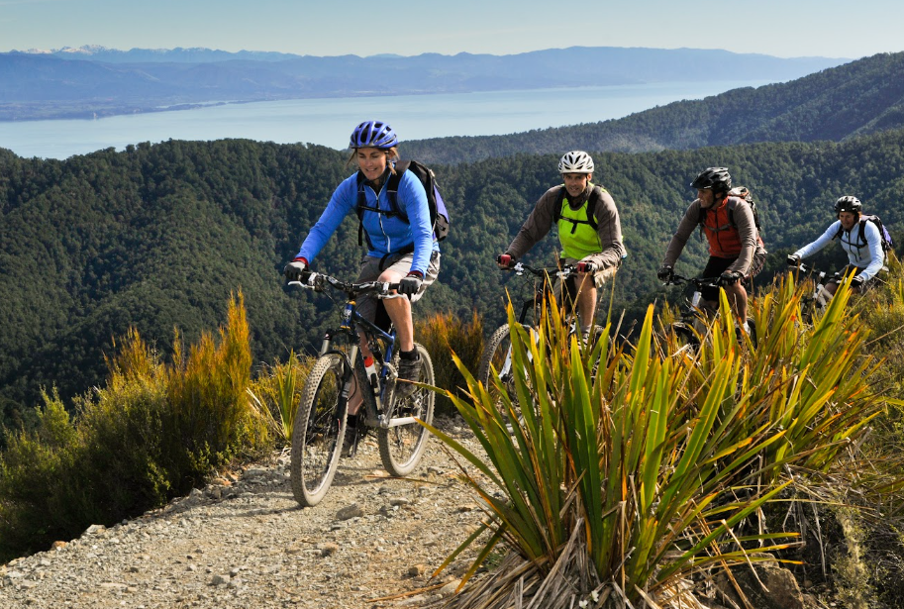
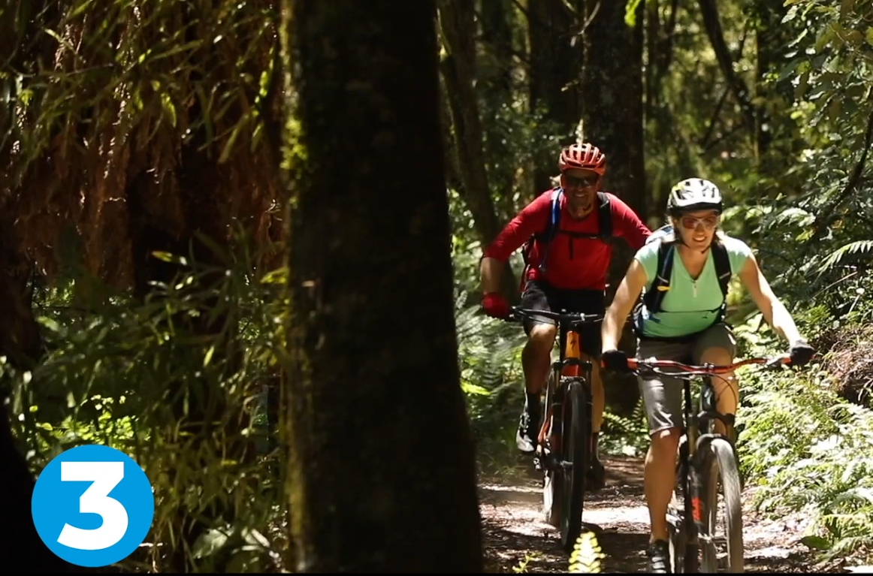
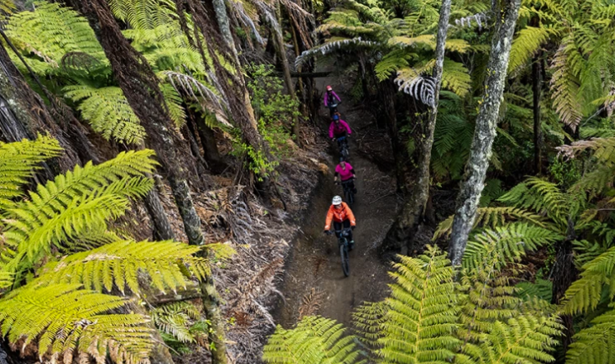
Grade 3 – intermediate trails with moderate hills & some rougher terrain

Slide 10
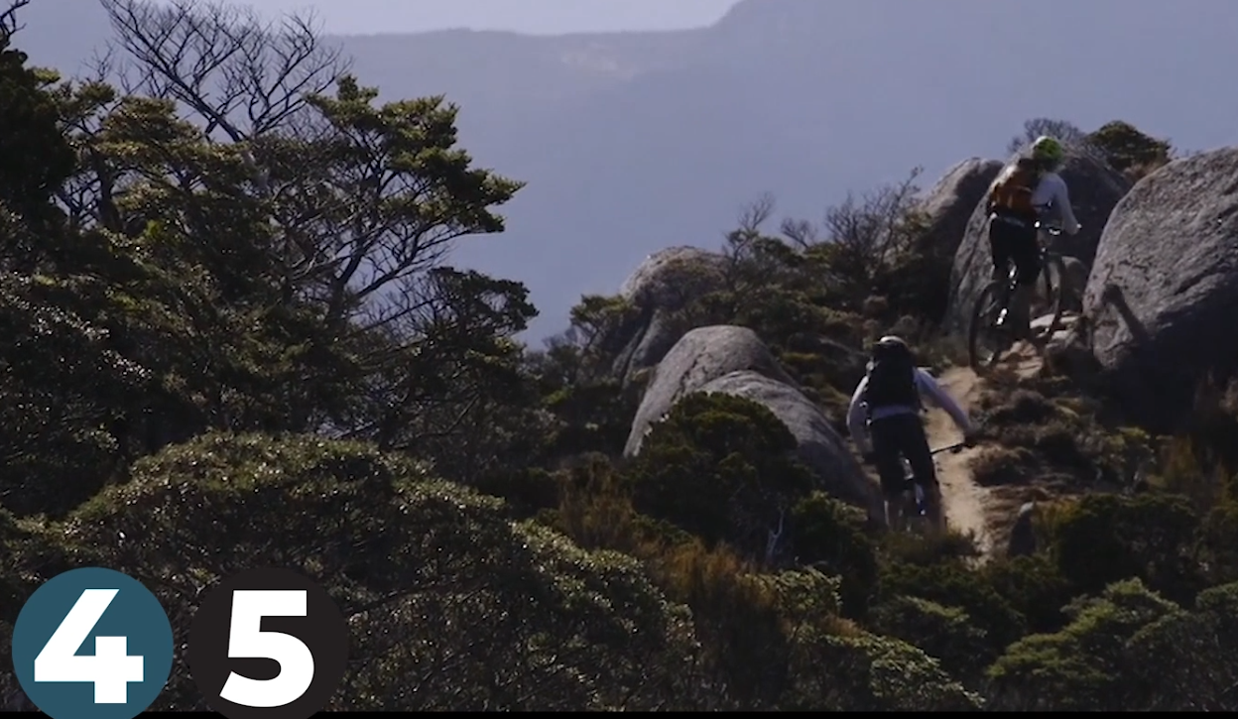
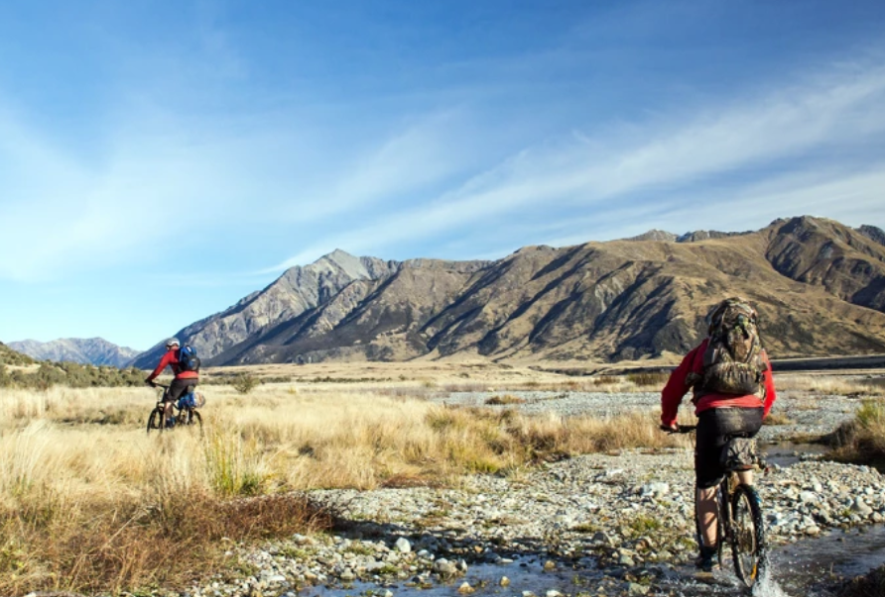
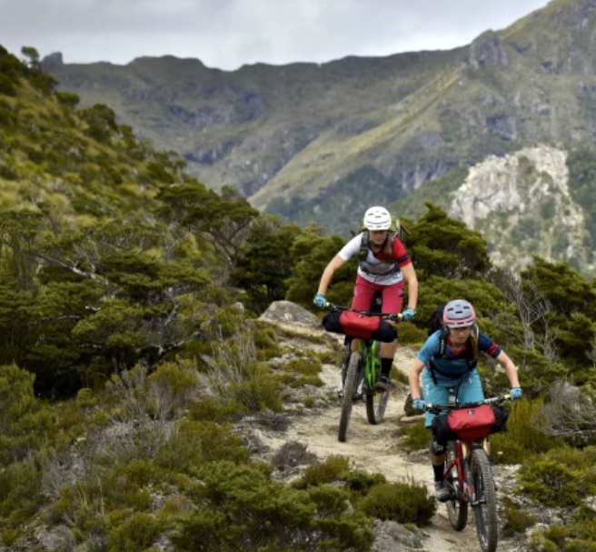
Grade 4 & 5 – more suitable for mountain bikers,
may cover steep, rugged, remote terrain.

Slide 11
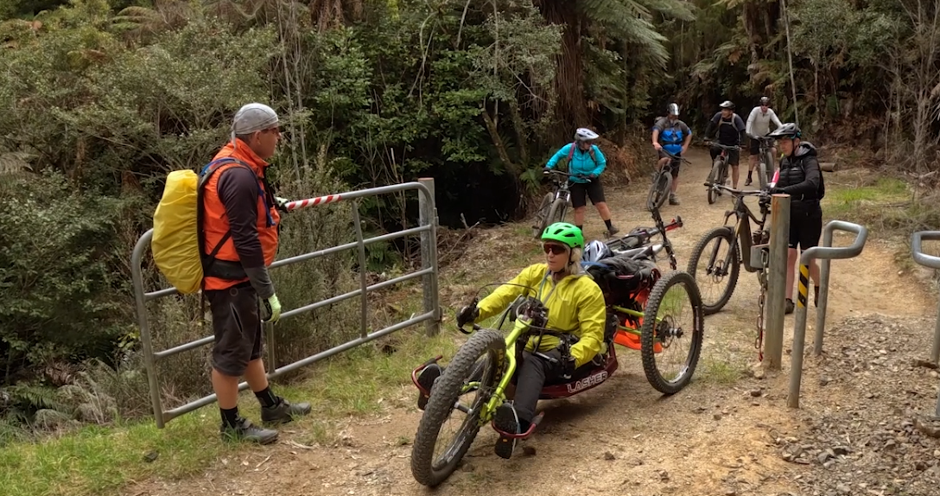
Accessible Great Rides for adaptive riders.

Slide 12
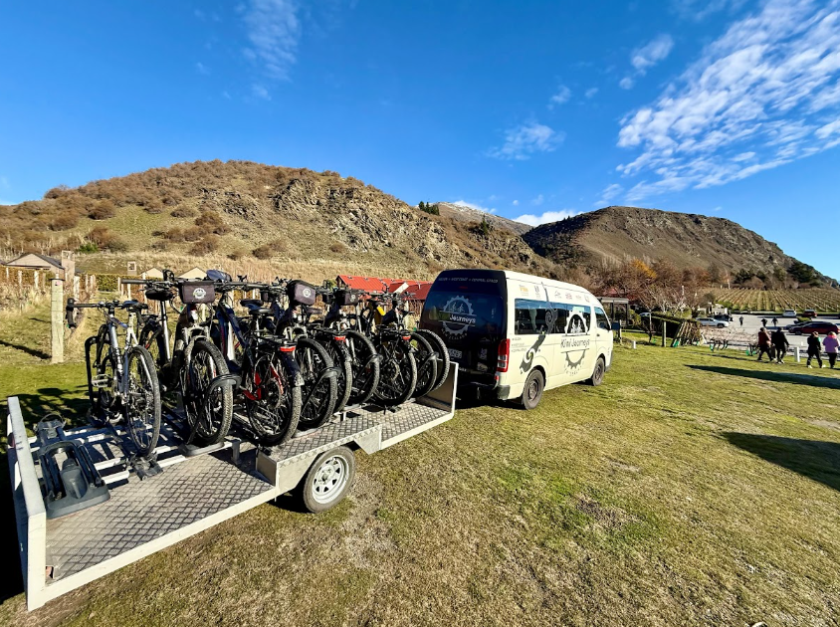
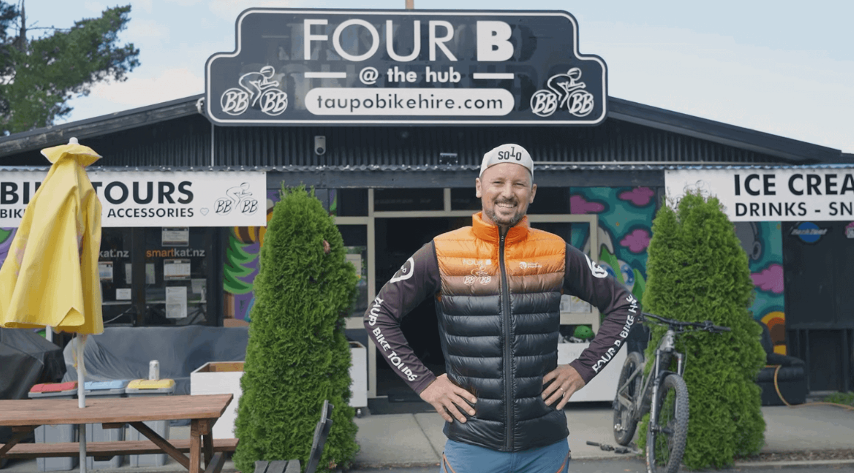
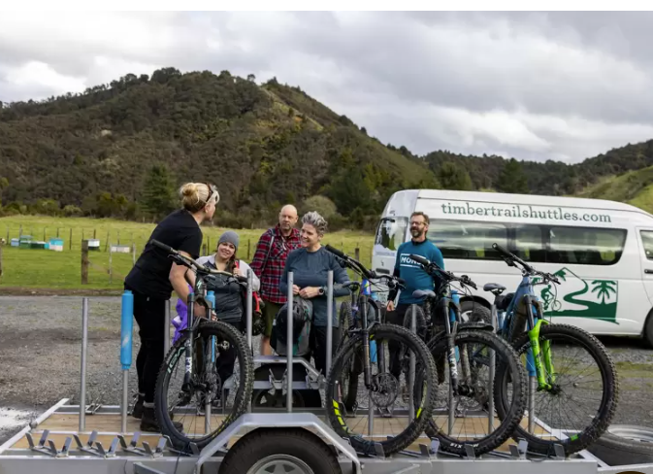
Fully supported – set departures, through to FIT (partial support, walk ups). Shuttle transfers. 1 hour – multi day.

Slide 13
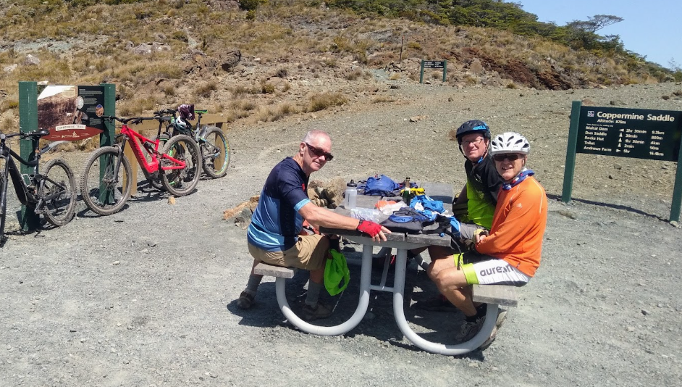
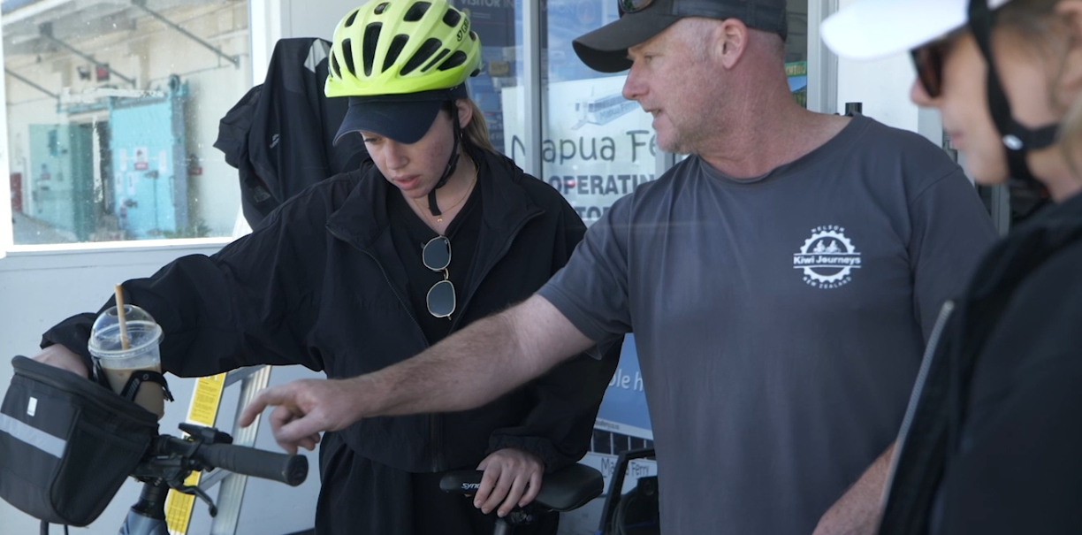
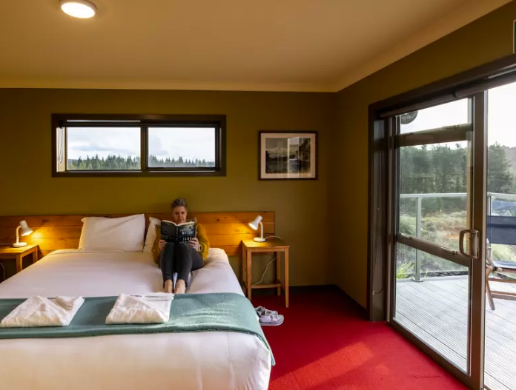
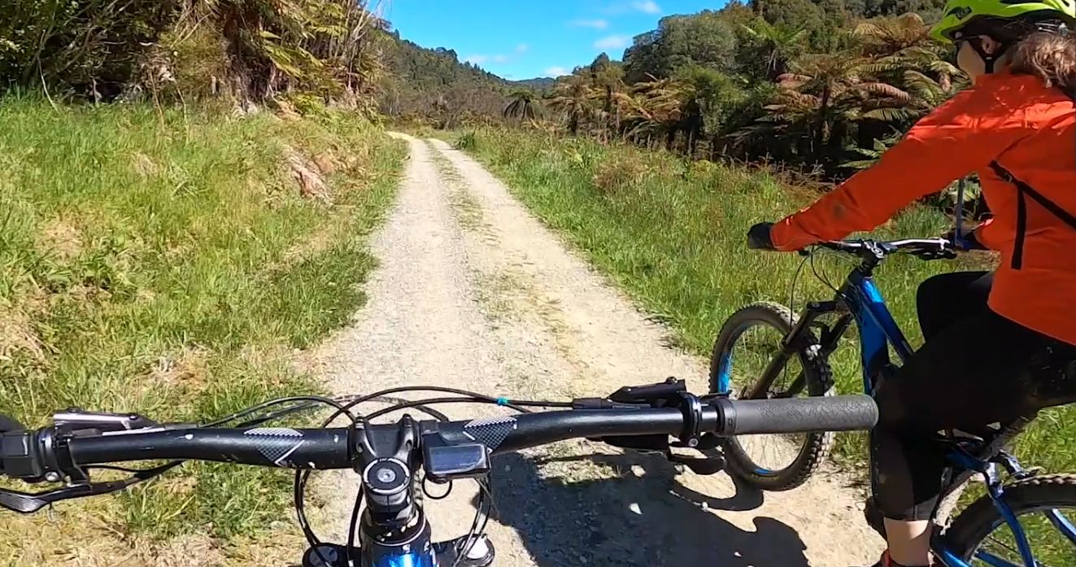
E-bikes welcome on all Great Rides.
Make sure there is sufficient battery charge.

Slide 14
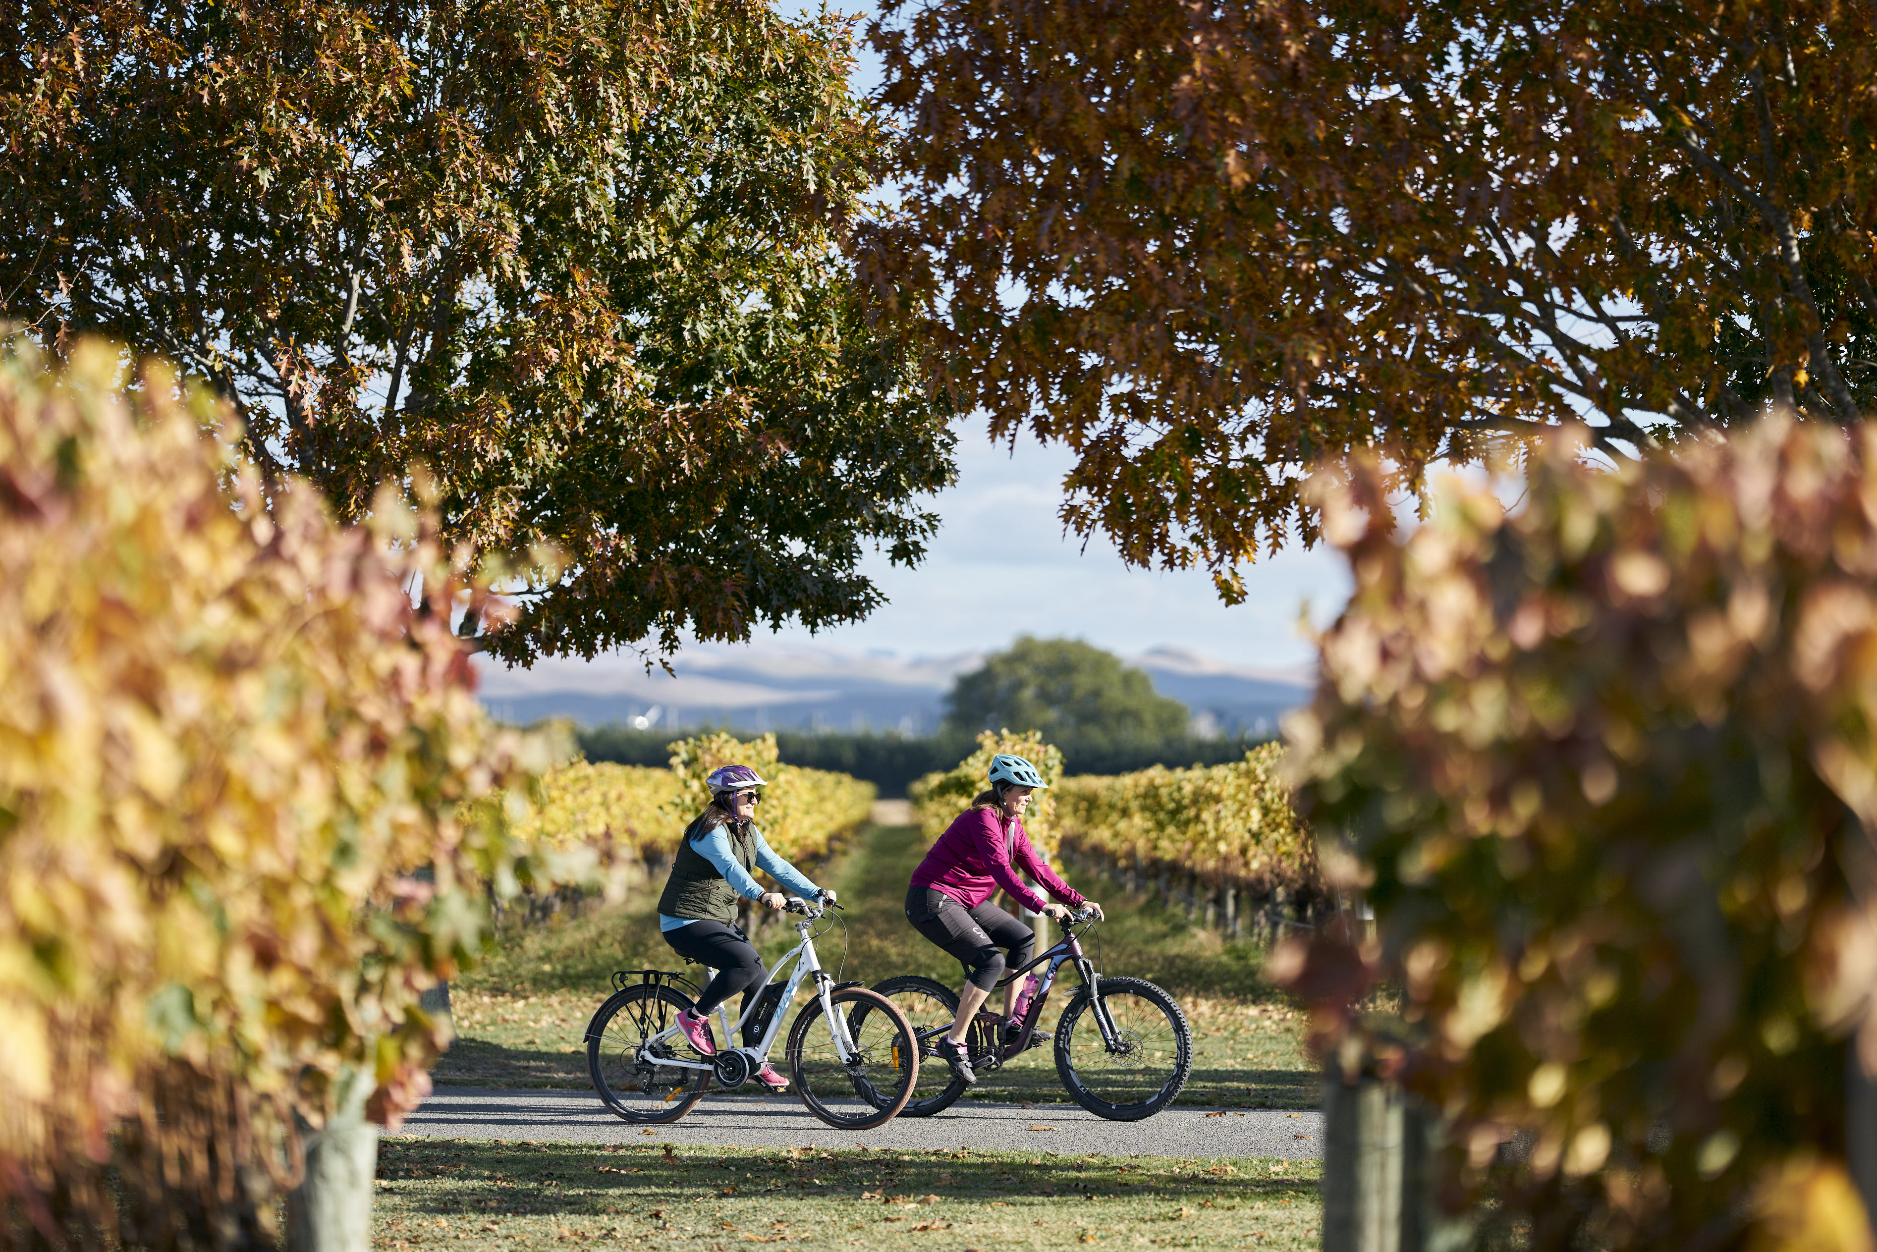
Selling The Right Experience
Type of client & their fitness level / cycling experience
  Family friendly
  Recreational Rider - Couples/Friends/Independent
  Hardcore rider
Availability of E-bikes (book ahead)
Heights and bike requirements (E bikes)
Accommodation 3-4 star plus / transfers
Partially supported vs fully supported
Build into a New Zealand Itinerary – North & South
Passion Points – wine & food, culture …

Slide 15
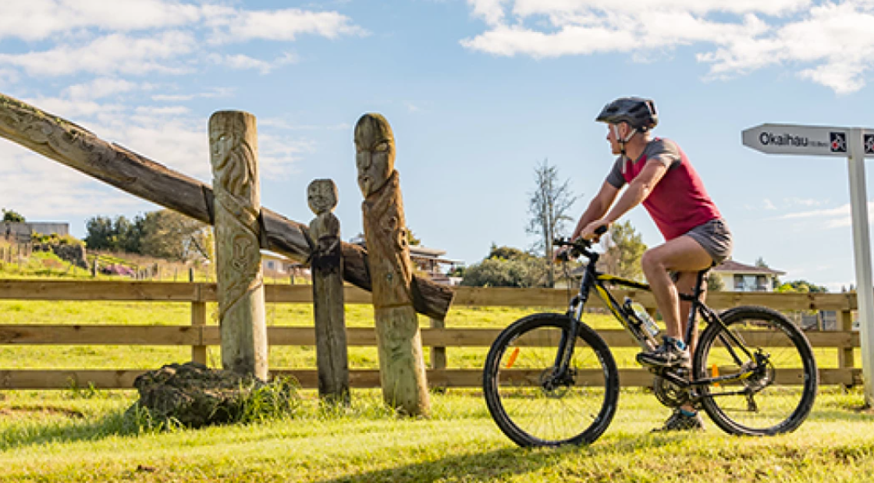
Trade Resources – www.nzcycletrail.com/trade
Visit our website – www.nzcycletrail.com
Email: angela@nzcycletrail.com

